Slide 1



Team TBD – IDETC Hackathon 2023
Ronnie Stone, Phillip Gavino
Problem 2: Exascale Material Design
Notes:
Good afternoon everyone

Slide 2
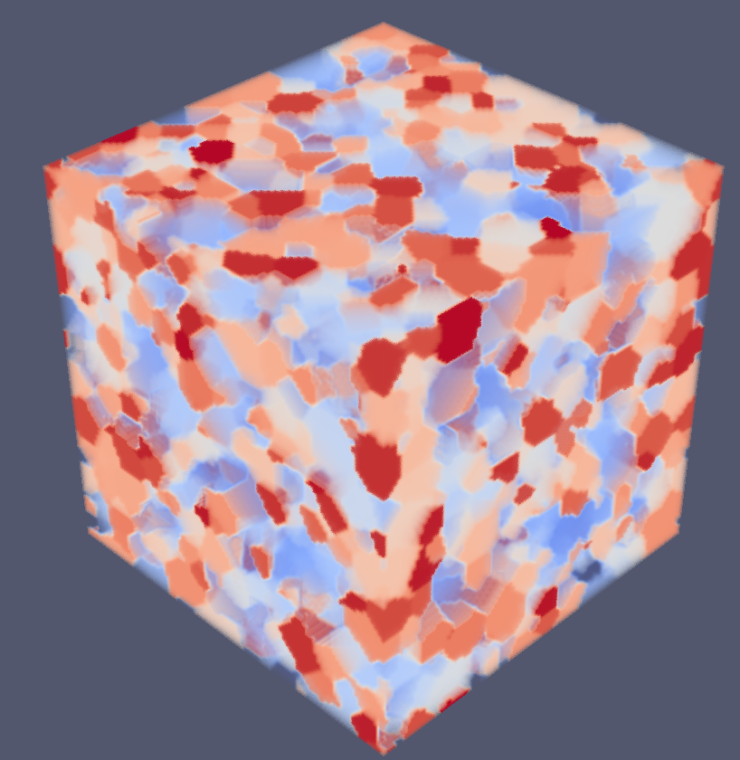
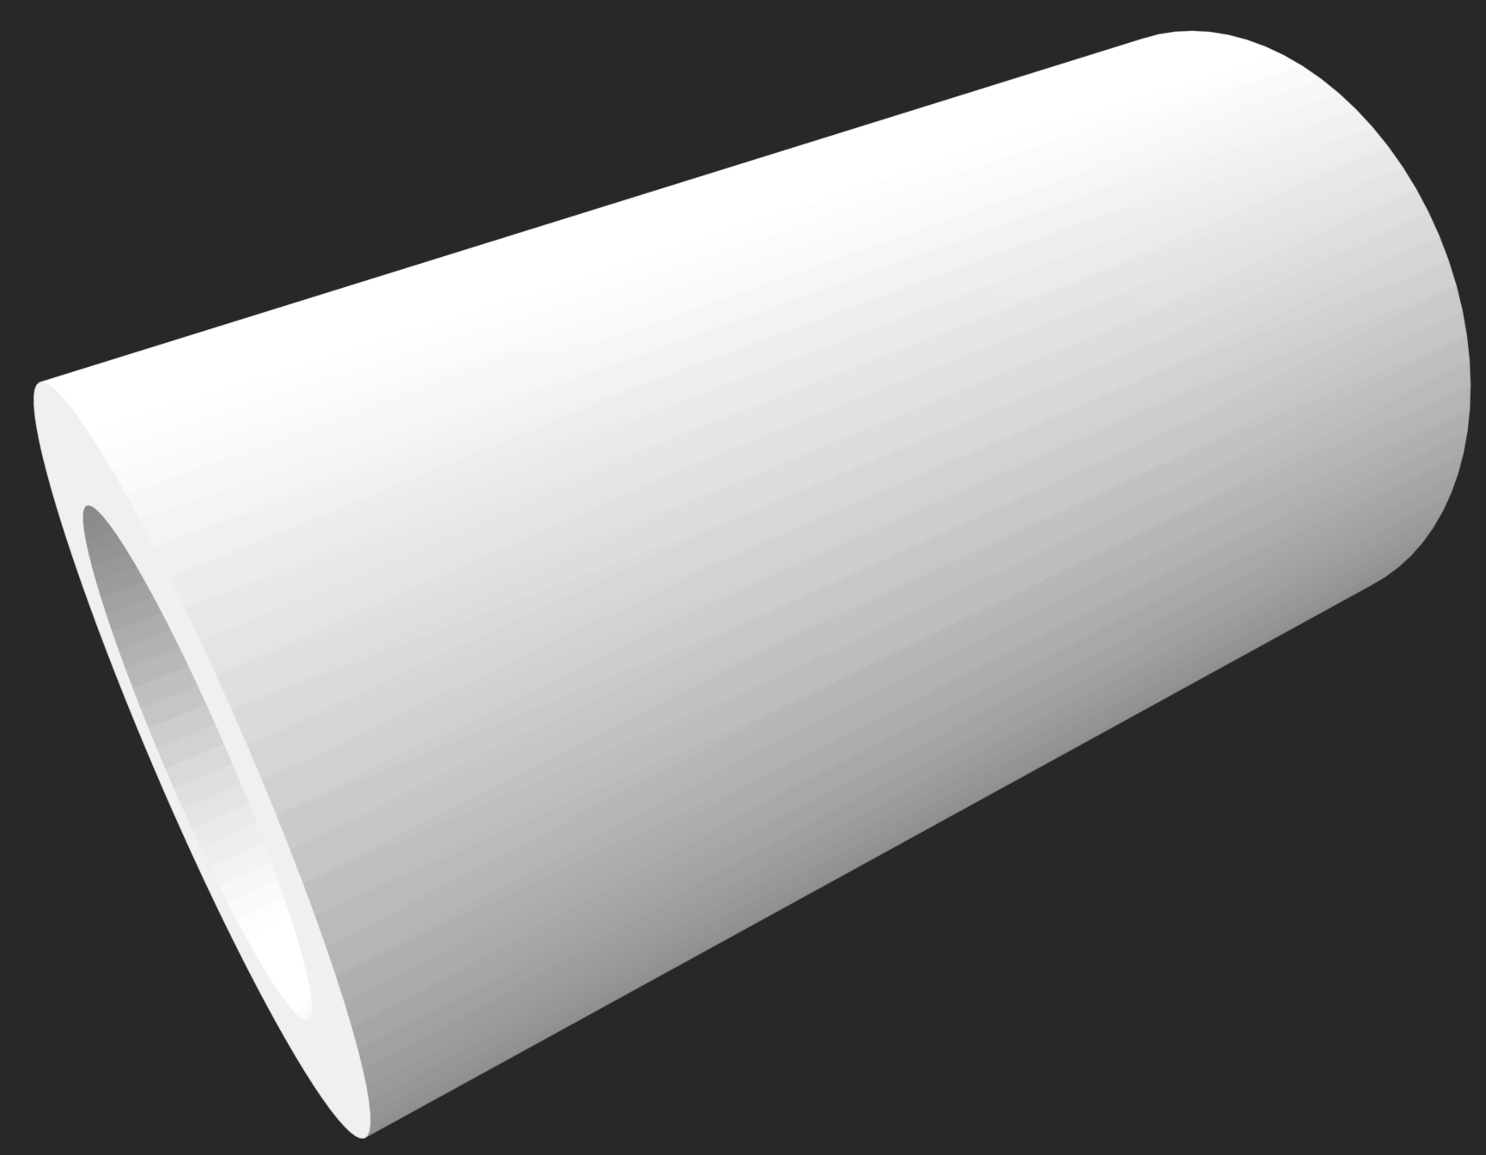

Introduction
The main goal is to synthetize the texture of CAD models using microstructure data generated by SPPARKS.
Arbitrary Microstructure
Arbitrary CAD Model

Slide 3
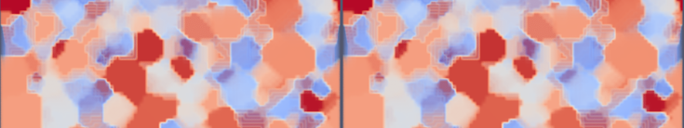
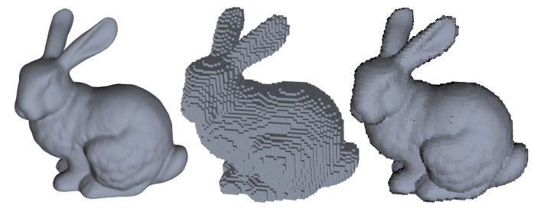
Assumptions
SPPARKS provides us with 1000s of microstructures. We assumed we could use any number (including only one) of them to texturized the CAD file.
The final texturized CAD file needs to be realistic. We assumed that the spin ID transitions within the model are smooth in all axes.
Smooth Boundary
We assume that we can voxalize the CAD model in any way we want while using a resolution of at least 10 micrometers.
Canonical Stanford Bunny Model

Slide 4
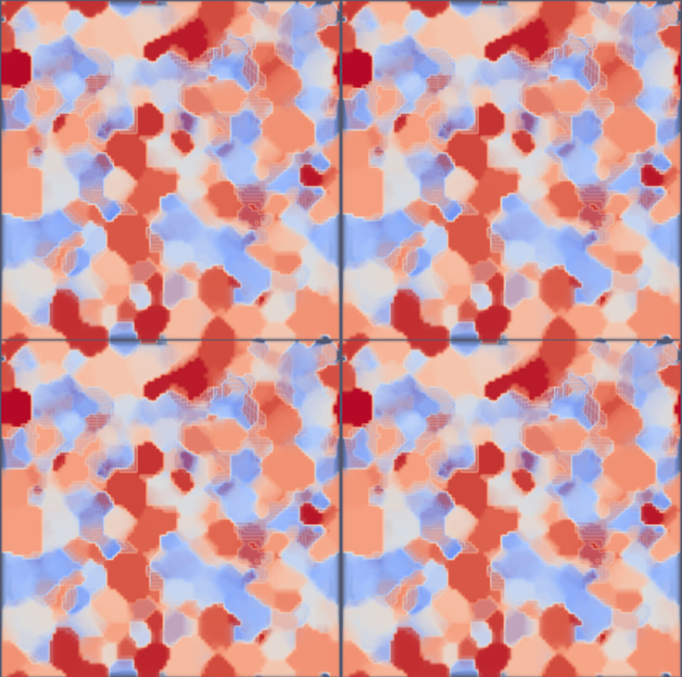
Methodology - Overview
Given our assumptions, our main approach was to take advantage of the periodicity of the microstructures.
z
seed-001-potts_3d.50
Side profile connected in a tile-like fashion
x
y
Therefore, we can voxalize the original CAD model and populate it with one periodic microstructure at a time to generate different textures.
To do that efficiently, we must perform some rescaling and stacking operations.

Slide 5
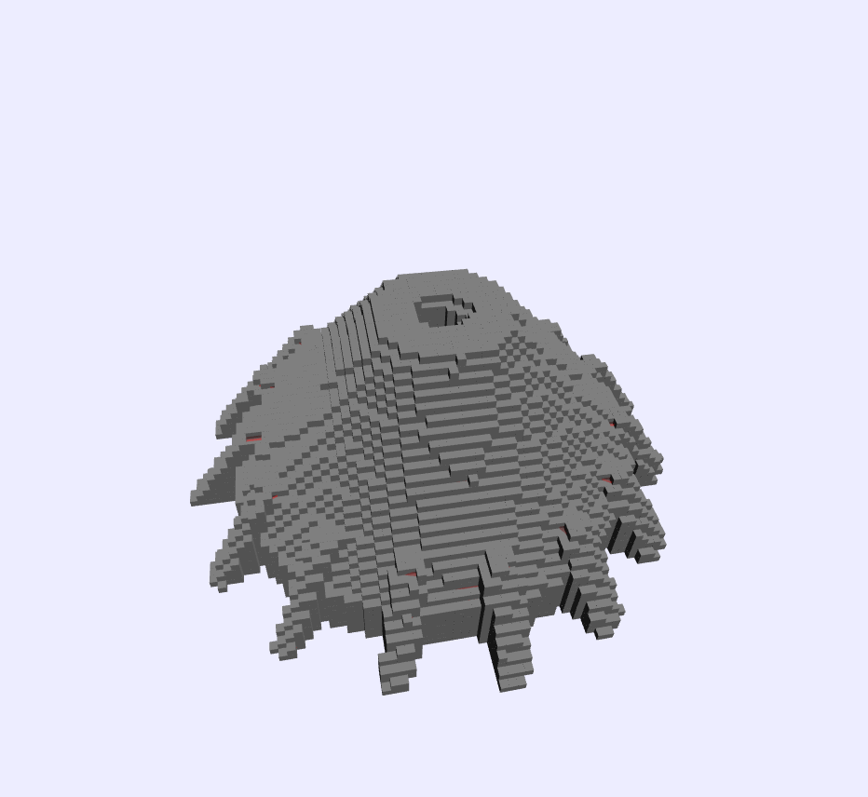
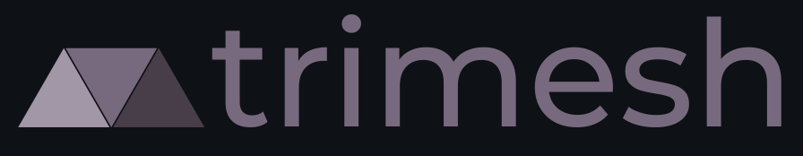

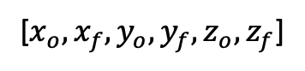
Methodology - STL Voxalization
First, we start by voxalizing the CAD model.
[$x_{o}, x_{f}, y_{o},y_{f}, z_{o},z_{f}$]
Bounding Box in 3 Dimensions

Slide 6
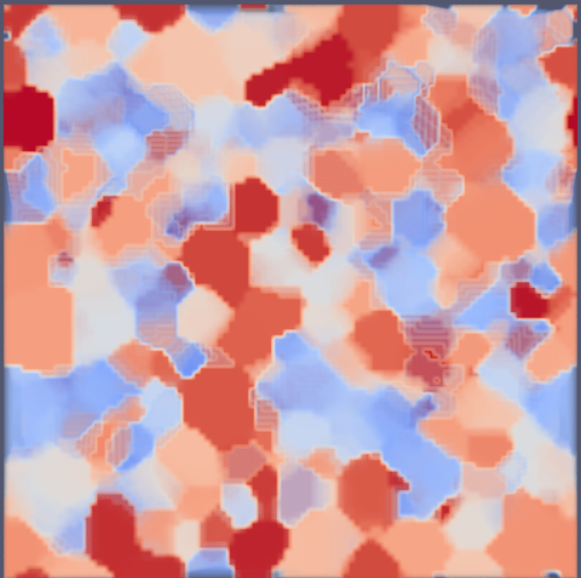
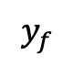
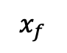
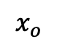
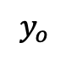
Methodology – Microstructure Rescaling
Second, we use the bounding box information to rescale the microstructure while keeping it periodic.
$$x_{o}$$
$$x_{f}$$
$$y_{f}$$
$$y_{o}$$

Slide 7
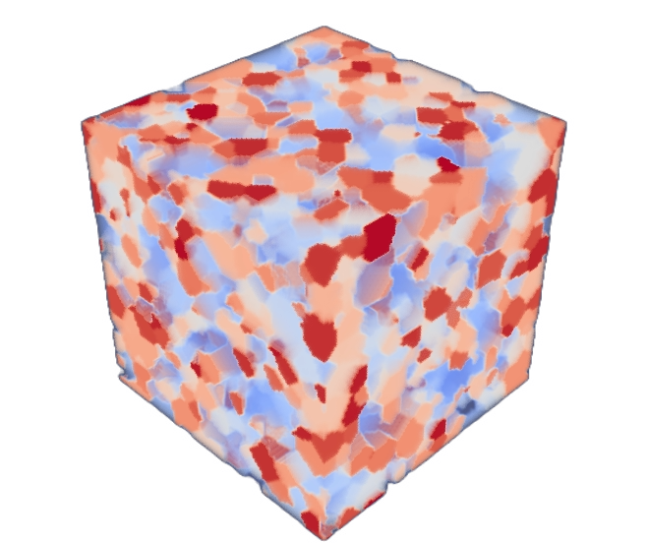
Methodology – Mapping STL and Microstructure
Finally, we map them to the same frame of reference and perform a nearest neighbor calculation to match the spin IDs of each voxel.
Overlay
Build KD-tree using rescaled microstructure
Assign each voxel a spin based on KD-tree
O(n log(m))
n: voxels in STL
m: voxels in microstructure

Slide 8
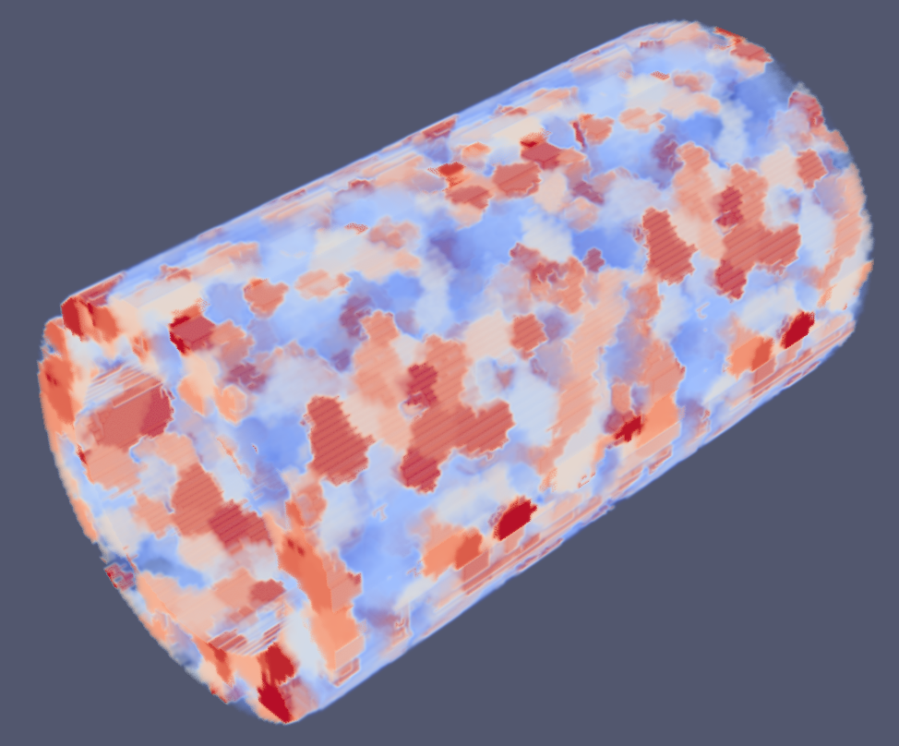
Results - Tube
Average Runtime: 20s

Slide 9
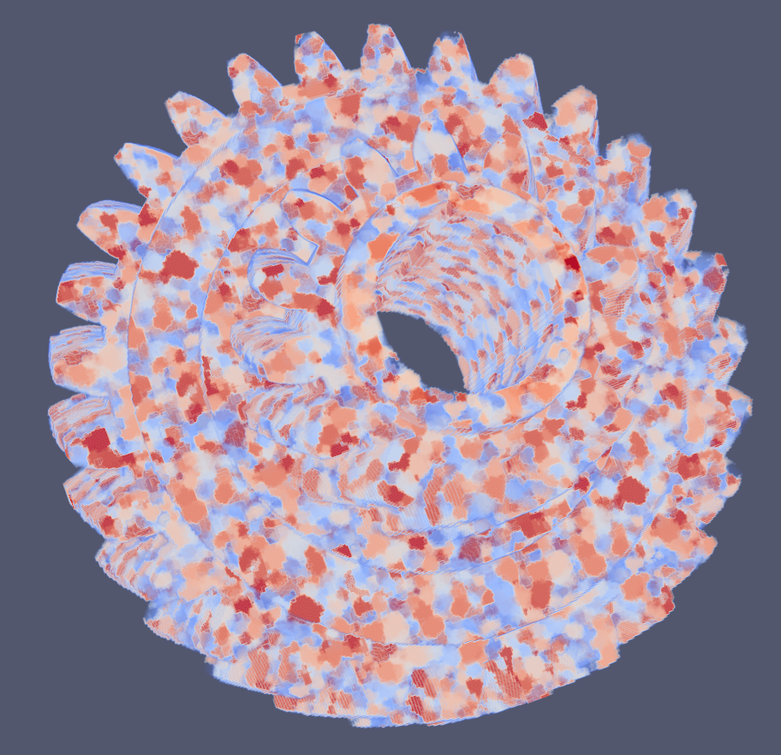
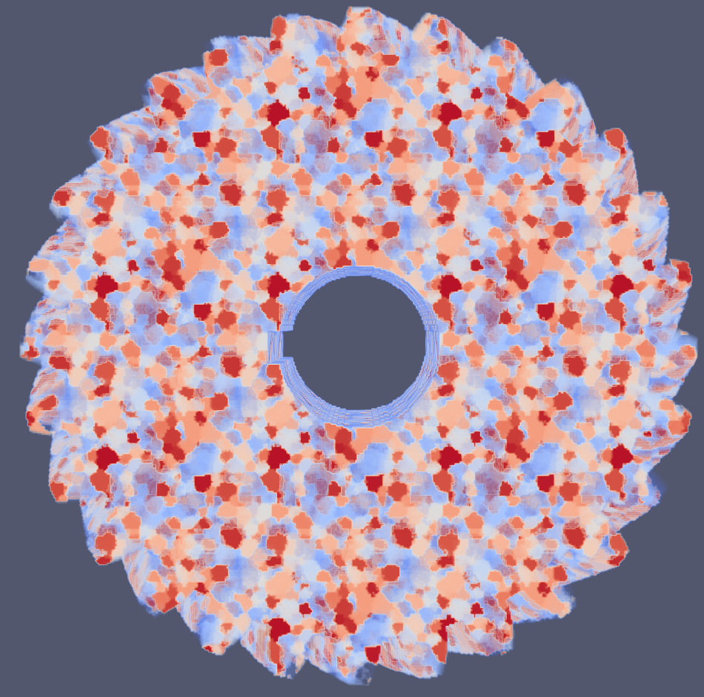
Results - Helical Gear
Average Runtime: 165s

Slide 10
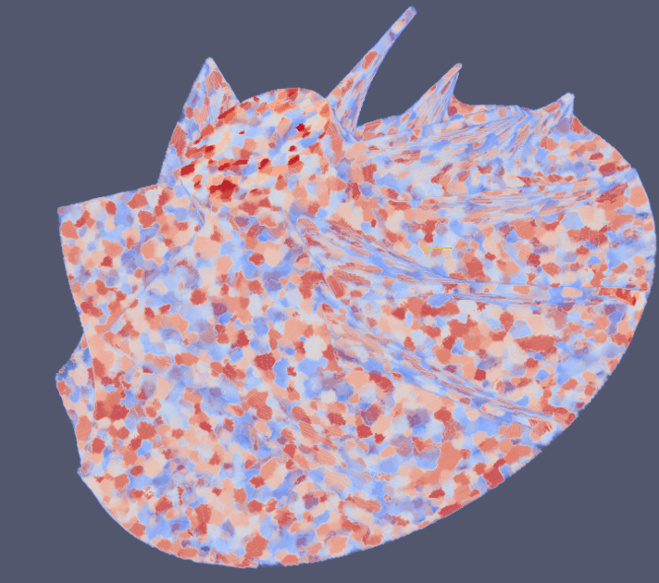
Results - Turbo Blade
10 different textures
From 001 to 010 dataset

Slide 11
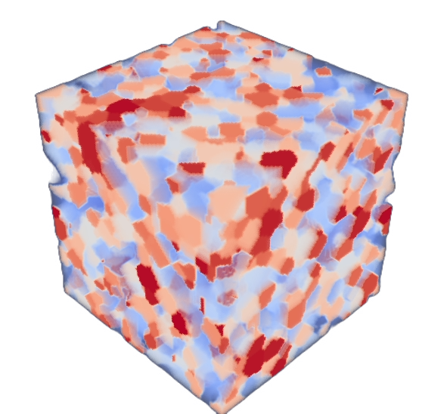
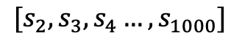
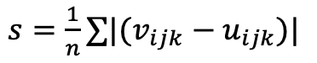
Future Work – Multiple Microstructures
If we disregard the need for periodicity, we can use multiple microstructures with a few tweaks in our algorithm.
Compare boundaries that
can stack together
We iterate over each voxel in the boundary and assign a similarity score based on their spin differences.
+X face of 001:
$$[s_{2},s_{3}, s_{4}…, s_{1000}]$$
Where generally:
$s=\frac{1}{n}∑|(v_{ijk}−u_{ijk})|$

Slide 12
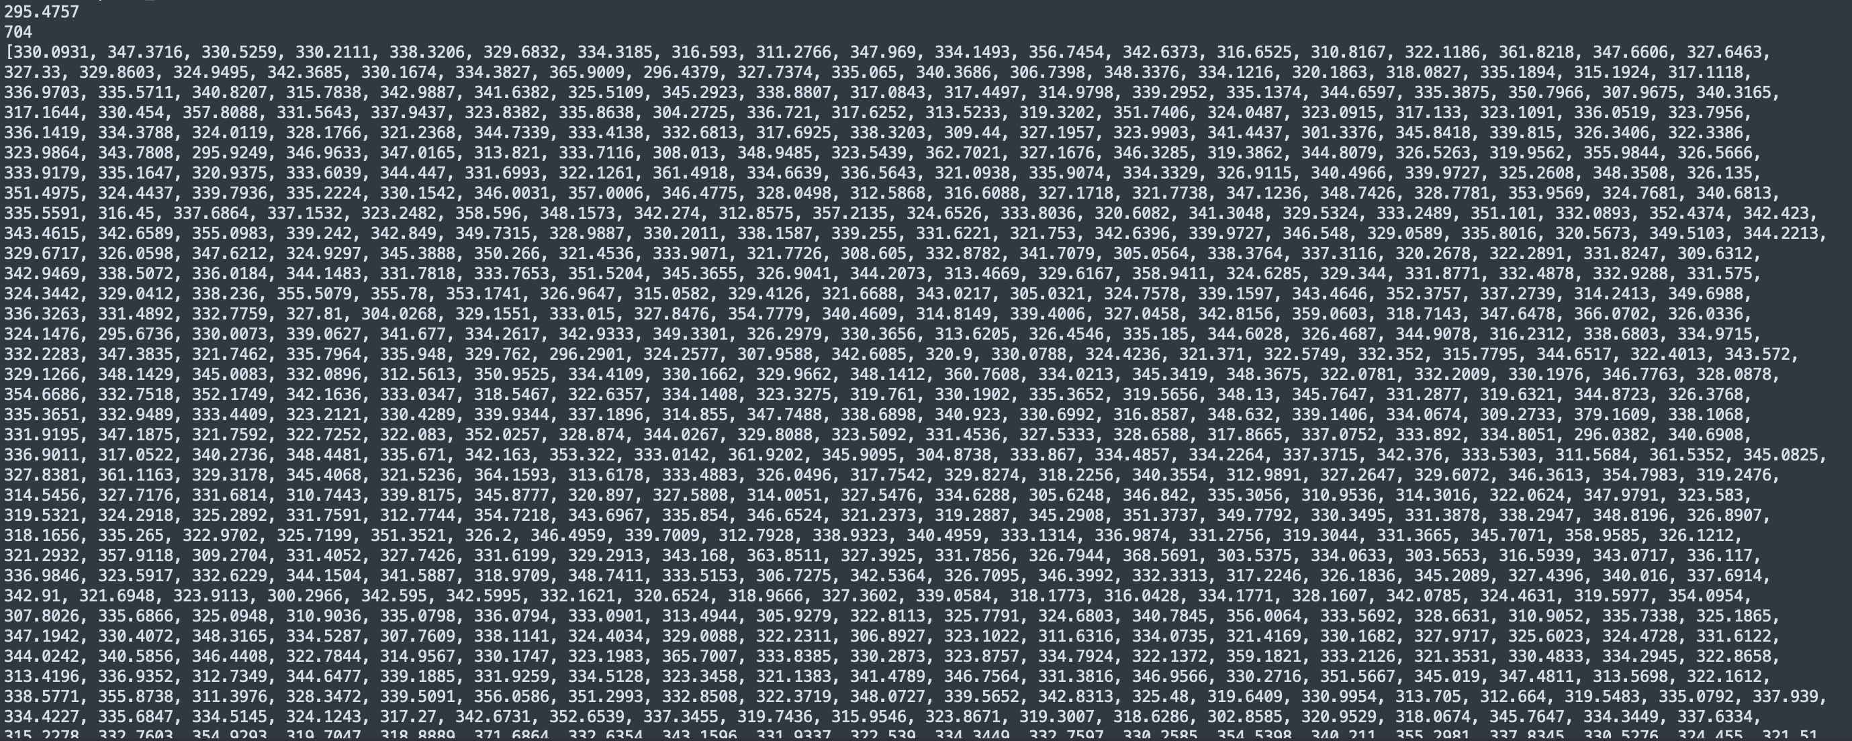
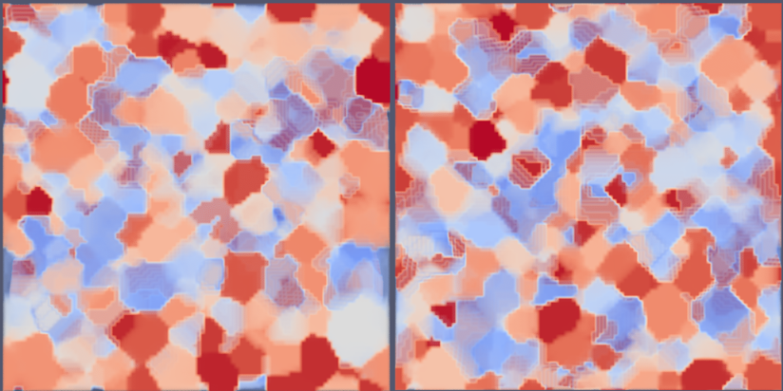
Future Work – Multiple Microstructures
We performed this analysis for microstructure 001 as a baseline:
The closest match is 704

Slide 13
Future Work – Multiple Microstructures
After we perform a similarity analysis, we can stack the microstructures that have the lowest differences.
However, we can go further by assuming that we are allowed so slightly modify the boundaries of each microstructure.
Left side is 001
Right side is 704
By progressively averaging out the spin IDs we can ensure smooth transitions:
Left side is 001
Right side is 704

Slide 14
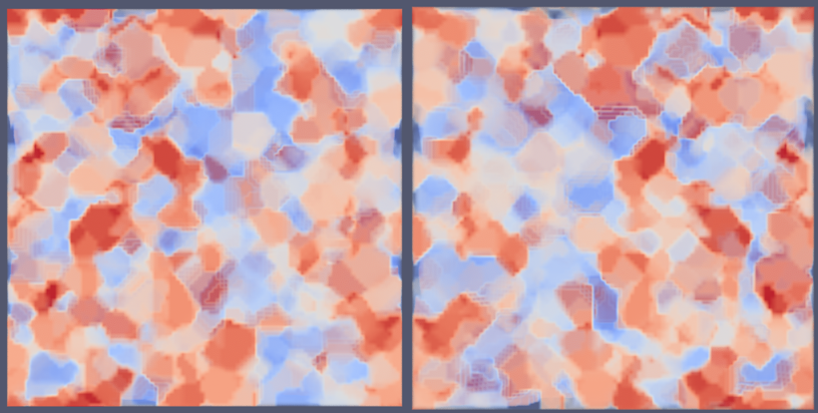
Future Work – Proof of Concept
We show that this smooths out the transitions between different microstructures while keeping their interiors unique and faithful to the SPPARKS output.
Robustness of algorithm is maintained but
now without periodicity
Fold on itself and boundaries are matching
Stacking process now based on similarity metrics

Slide 15


Thank you!
SiDi Lab
Ronnie Stone Graduate Ph.D. Student
Phillip Gavino Graduate Master's Student
Emails:
ronnie.stone@utexas.edu
phillip.gavino@utexas.edu

